Slide 1
Image Processing
Image Zooming
Image zooming is based on the zero-order hold interpolation method of increasing the dimensions of an image, but it, instead, produces an image of the same dimensions as the input one. The output image contains only part of the original image, which is zoomed based on a zoom factor.
For this exercise you are tasked to perform image zooming on an image.

Slide 2
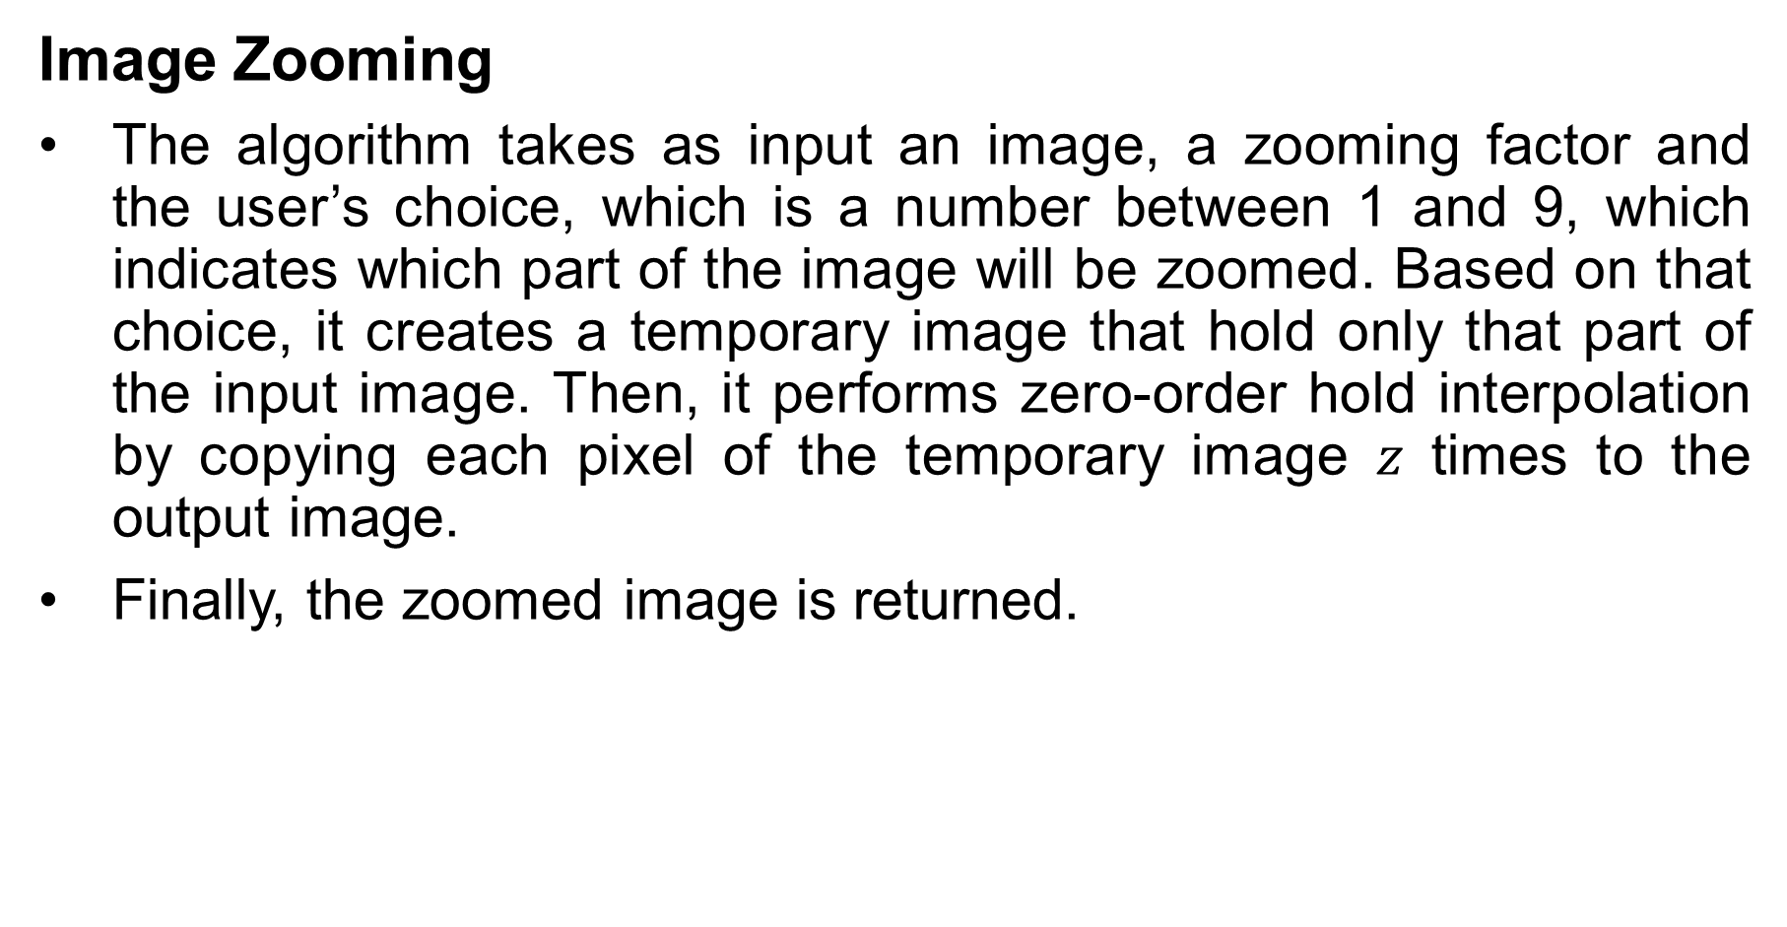
Image Processing
Image Zooming
The algorithm takes as input an image, a zooming factor and the user’s choice, which is a number between 1 and 9, which indicates which part of the image will be zoomed. Based on that choice, it creates a temporary image that hold only that part of the input image. Then, it performs zero-order hold interpolation by copying each pixel of the temporary image $z$ times to the output image.
Finally, the zoomed image is returned.

Slide 3

Image Processing
Image Zooming
Input example.
Intermediate output example (zooming factor is 2 and user’s choice is 5, which corresponds to the middle part of the image).

Slide 4

Image Processing
Image Zooming
Output example (zooming factor is 3 and user’s choice is 2, which corresponds to the top-right part of the image).

